Slide 1
Startup Connect
Group Members :
Khadim Hussain 2021-CS-204
Azman Shakir 2021-CS-176
Saqib Shehzad 2021-CS-187
Nasir Kamal 2021-CS-192

Slide 2
Purpose:
This project aims to support startups in raising capital and gaining exposure by offering crowdfunding support and a platform for investors to collaborate and share investment opportunities. To simplify the complex process of negotiating funding deals, legal advisors will be available. Effective communication is essential, so a messaging facility will be provided. The platform will offer equity percentage, funding, and preferred shares for each phase of the startup progress, allowing users to customize their funding deals. Data analytics will help startups and investors make informed decisions, and access to industry experts and advisors will be available. The project will also serve as a platform for mentors to provide advice to founders. The platform will have a well-designed UI to facilitate the investment process.

Slide 3
Description:
The Founder, Mentor, and Investor can make their profile and add the required information.
The founder makes his profile and adds the required info about their skills to show to the investor.
The Founder can initiate his startup identity at the platform to collect funding.
The Founder can initiate his startup identity at the platform to collect funding.
The user can see the ideas of a person and can join them as a team and start their own as well.
The Founder of the program has the authority to add someone to the team.
The founder can create a pitch deck, which includes a business plan, financial projections, and other relevant details, to attract potential investors.
A mentor can give mentorship through a forum for program discussion.

Slide 4
Description:
The Founder, Mentor, and Investor can make their profile and add the required information.
The founder makes his profile and adds the required info about their skills to show to the investor.
The Founder can initiate his startup identity at the platform to collect funding.
The Founder can initiate his startup identity at the platform to collect funding.
The user can see the ideas of a person and can join them as a team and start their own as well.
The Founder of the program has the authority to add someone to the team.
The founder can create a pitch deck, which includes a business plan, financial projections, and other relevant details, to attract potential investors.
A mentor can give mentorship through a forum for program discussion.

Slide 5
CONT.
Investors can invest in different programs and one program can get many investments that are crowdfunding.
An official agreement is placed between investors and the program owners, and the members are the shareholders whose shares are decided by the owner.
A messaging feature is available for every user where they can connect privately.
The platform offers a comprehensive dashboard that displays all the essential data and metrics about the user’s program, funding, investments, and monthly/yearly Revenue of the Startup.
The investor can rate and review the program and its team members based on their performance, which can help other investors make informed decisions.
The platform provides advanced analytics and reporting features that allow users to analyze and track their program’s performance, funding, and investments in real time.

Slide 6
CONT.
The platform provides a feature for automatic payments to investors, based on the agreed terms and conditions of the agreement.
The platform offers a feature for the founder to issue equity to investors, which can be tracked in real-time using the dashboard.
The platform offers services such as payment gateways, analytics tools, and marketing services to enhance the user experience.
The platform provides a notification system that alerts users about any updates, new investments, or messages related to their program or investments.
The program owner can conduct surveys and polls to gather feedback from the team members, investors, and other stakeholders to improve the program's overall performance.

Slide 7
Project Actors
Admin :
The founder is the primary actor on the platform, possessing talent and ideas but lacking investment. They can display their abilities and concepts, and investors can reach out to them. They do not need to have a team. They can build their team by collaborating with others and others can join by seeking permission from the owner who created the program. The founder can connect with investors and mentors and finalize their deals with the investors.

Slide 8
Project Actors
Investror :
An investor is the for the platform. A community of investors is needed for getting funding for the startups. Investors come to the platform with capital and a desire to find fresh talent and ideas. By utilizing the platform, they can identify suitable individuals and communities to invest in and agree on becoming a shareholder or receiving profits until the entrepreneur repays the investment. The investor with minimum investing is also entertained as crowdfunding is supported.

Slide 9
Project Actors
Mentor :
Mentors are a crucial part of any startup. They can make a difference in the success of startups. In the early stages, the startup fails due to a lack of advice. The mentor can support startups for free and give paid sessions.
User :
The user can be a founder or Investor but also can join the team of the founder and can be a co-founder. This platform supports community building and equity so this actor is also important for team building.

Slide 10
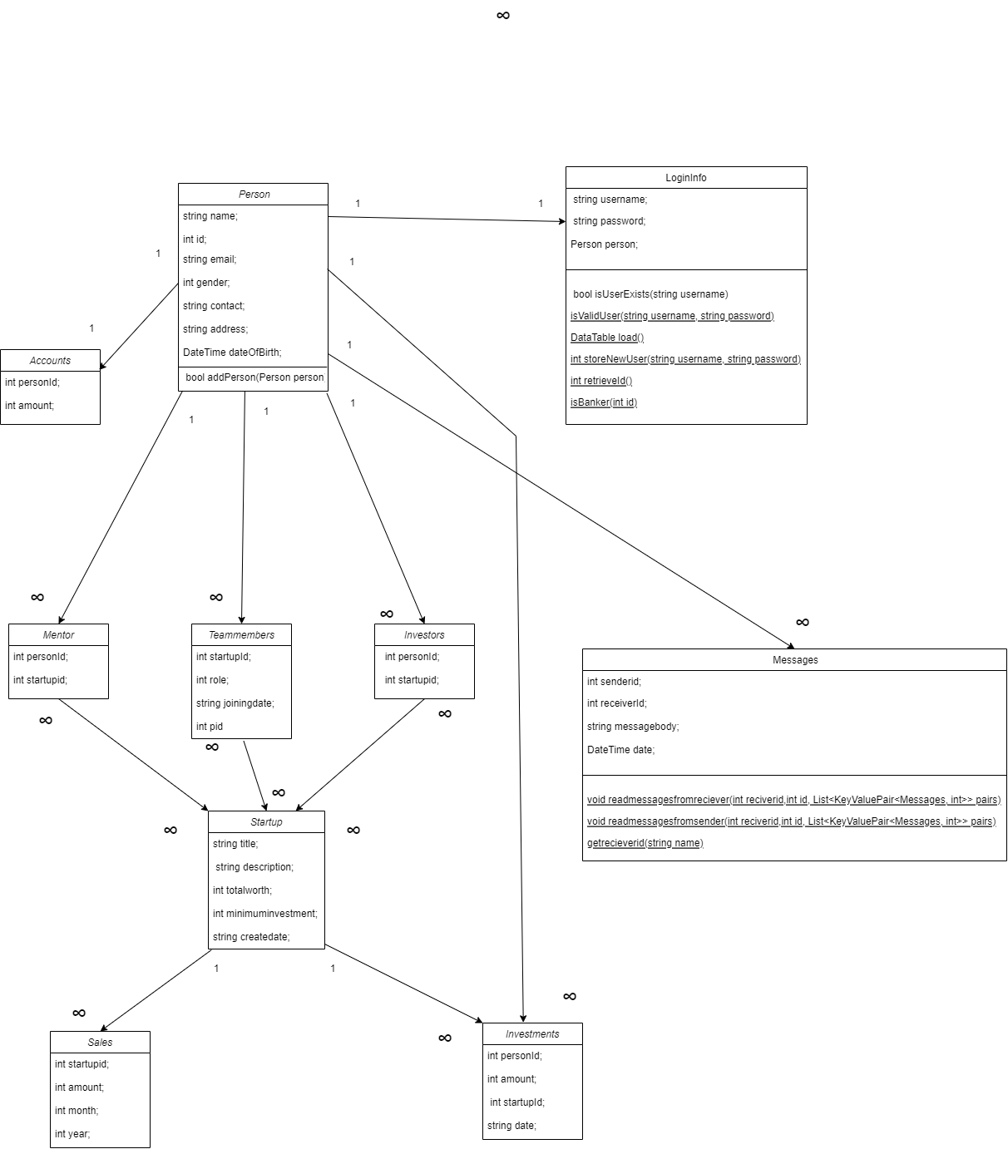
OOP Design

Slide 11
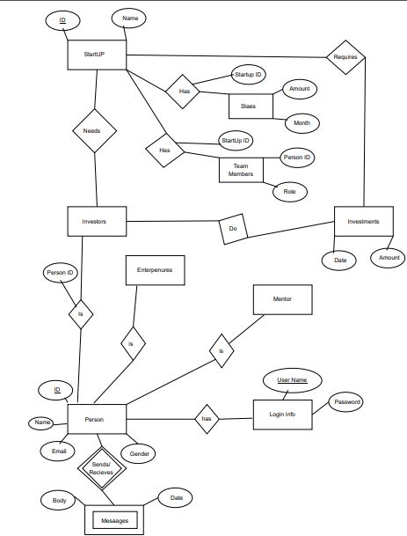
ER Diagram

Slide 12
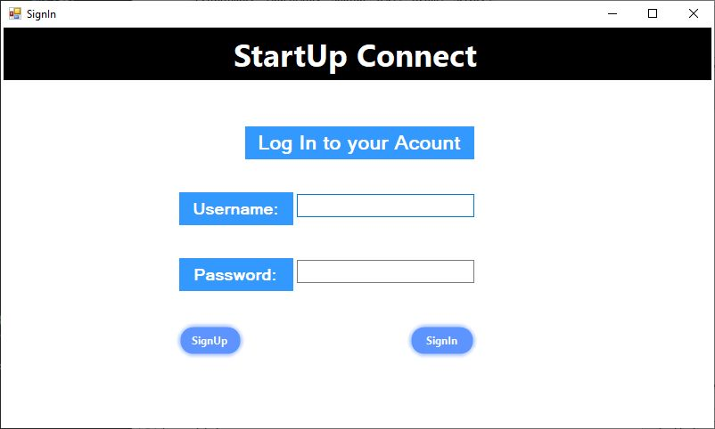
GUI Details
SignIn:

Slide 13
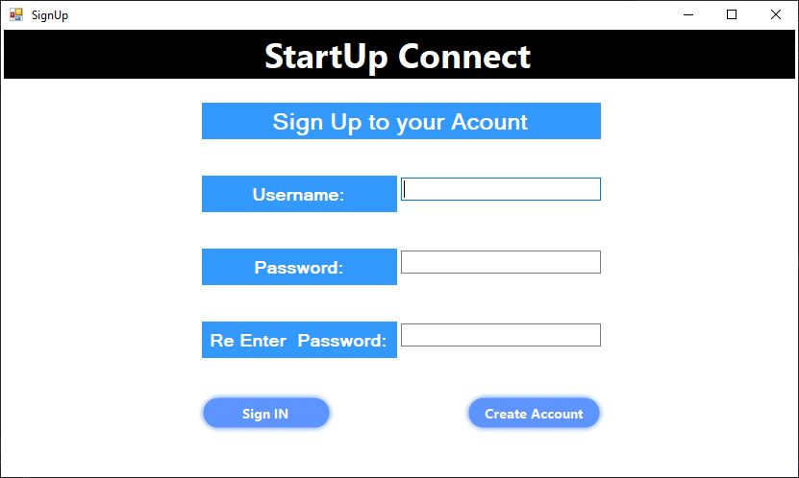
SignUp:

Slide 14
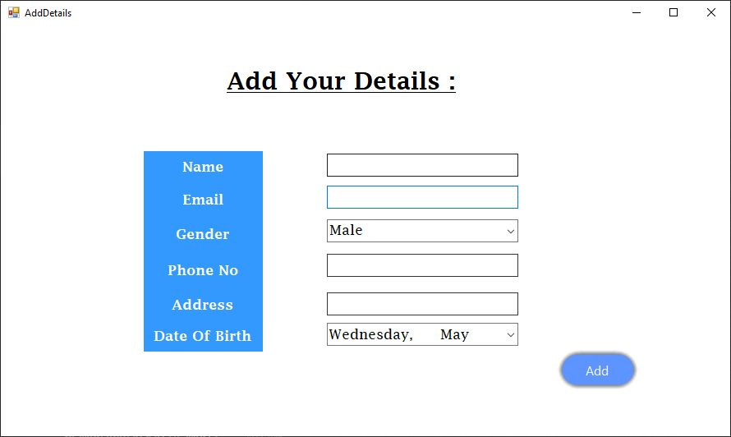
Person Details:

Slide 15
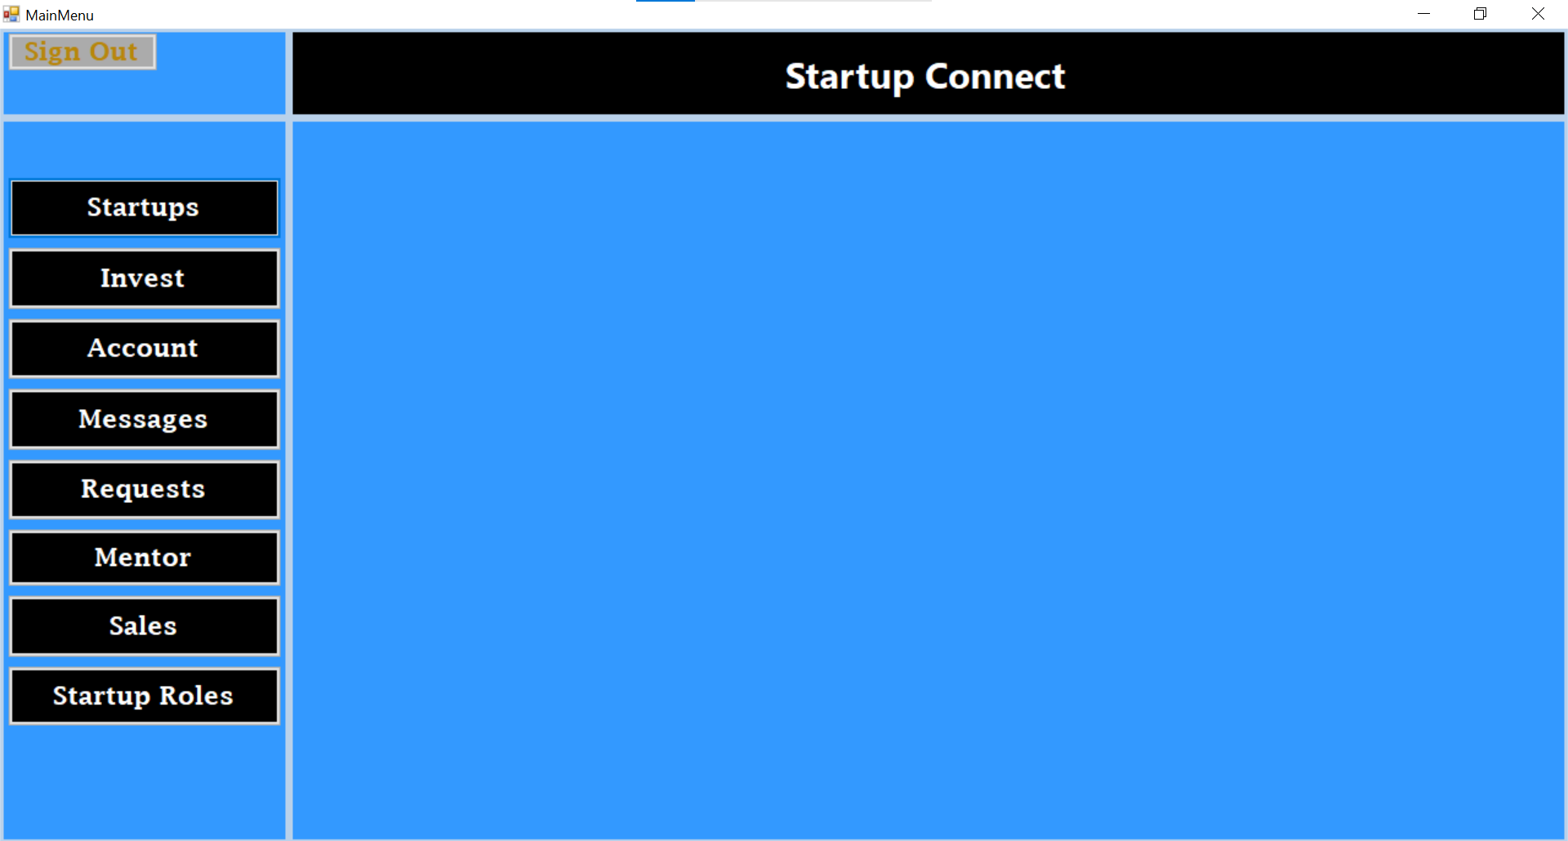
MainMenu:

Slide 16
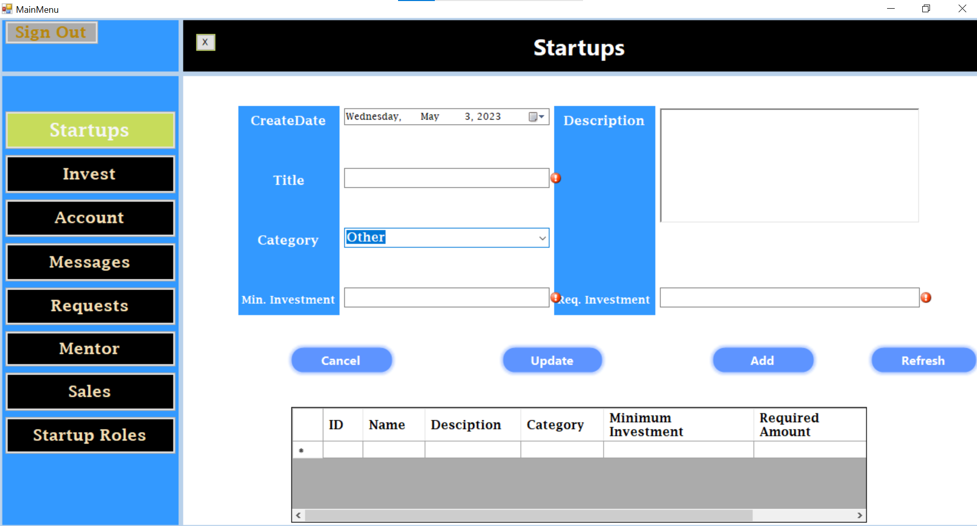
Startups:

Slide 17
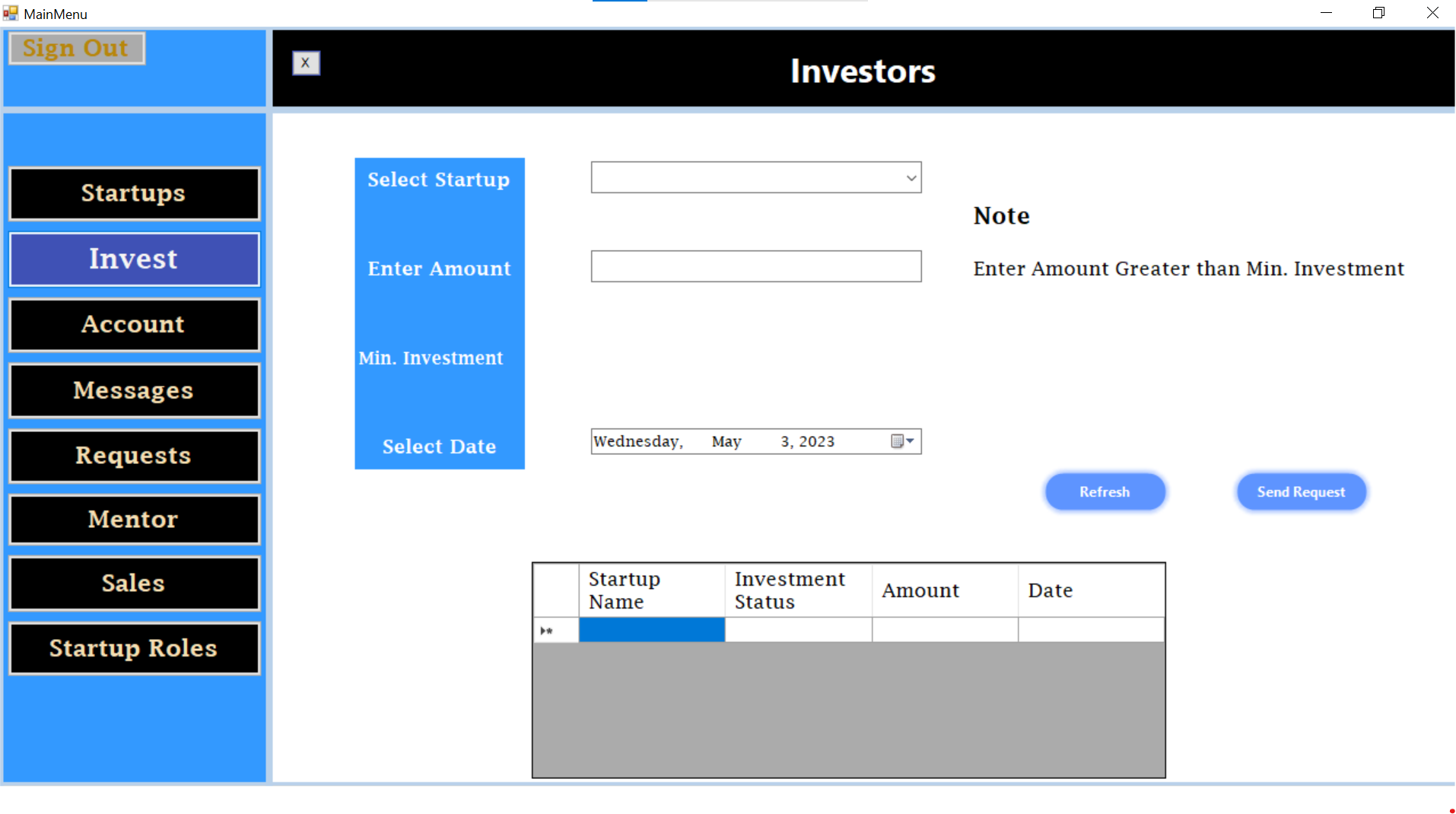
Investors:

Slide 18
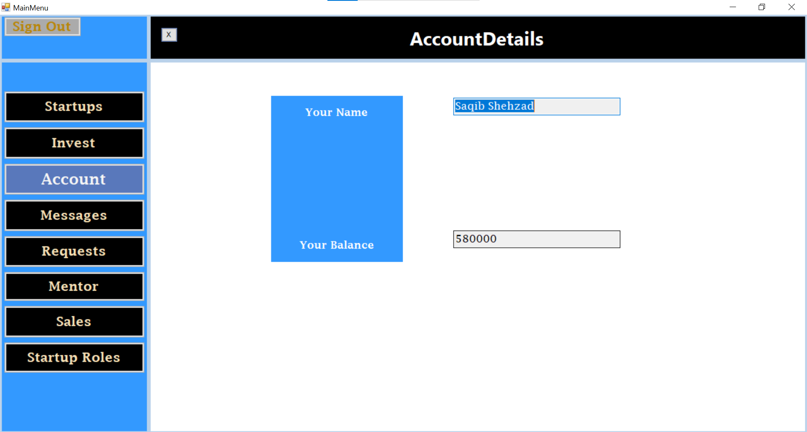
Account:

Slide 19
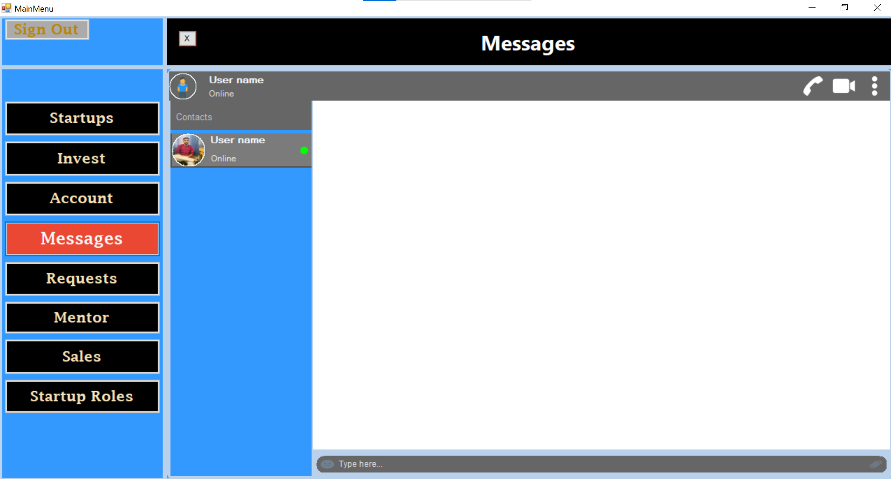
Messages:

Slide 20
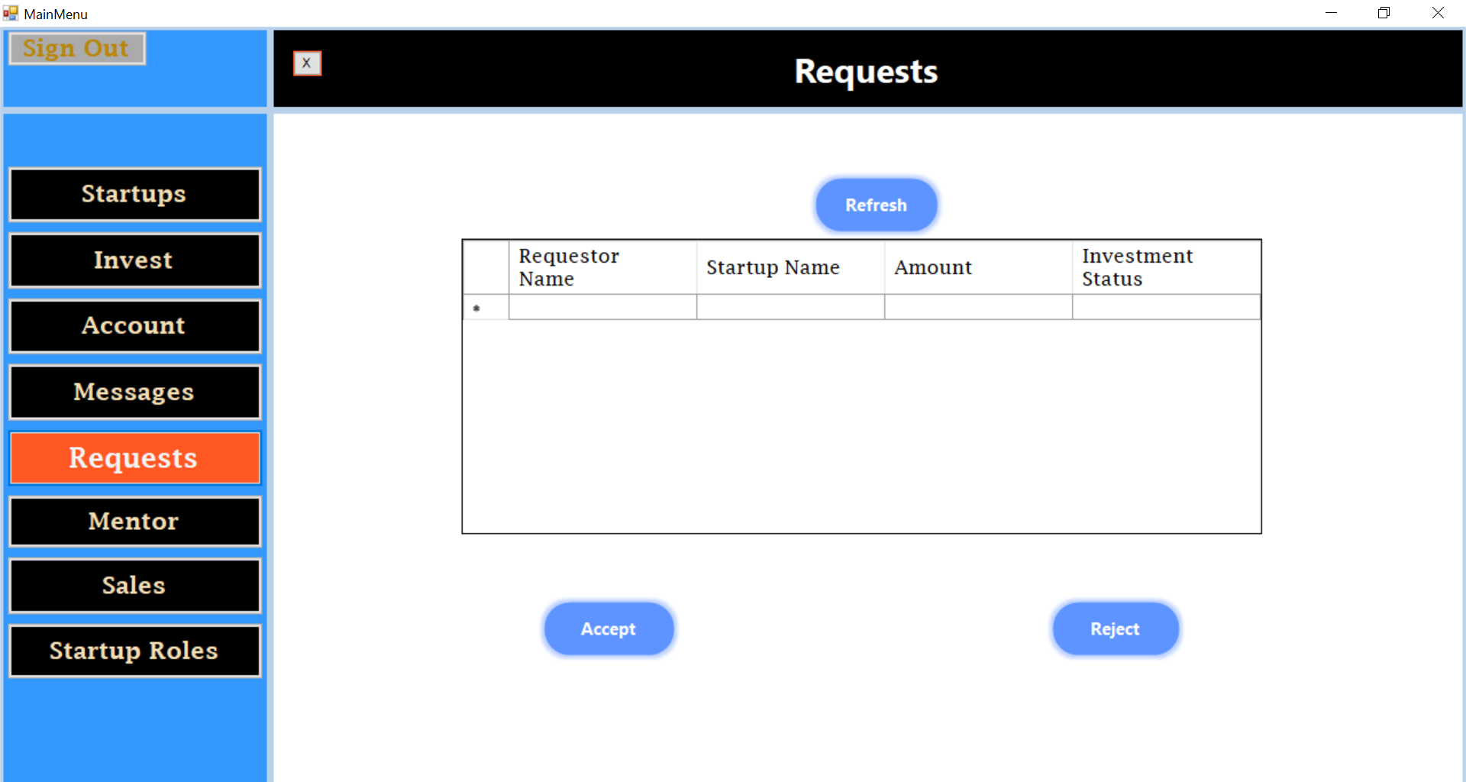
Requests:

Slide 21
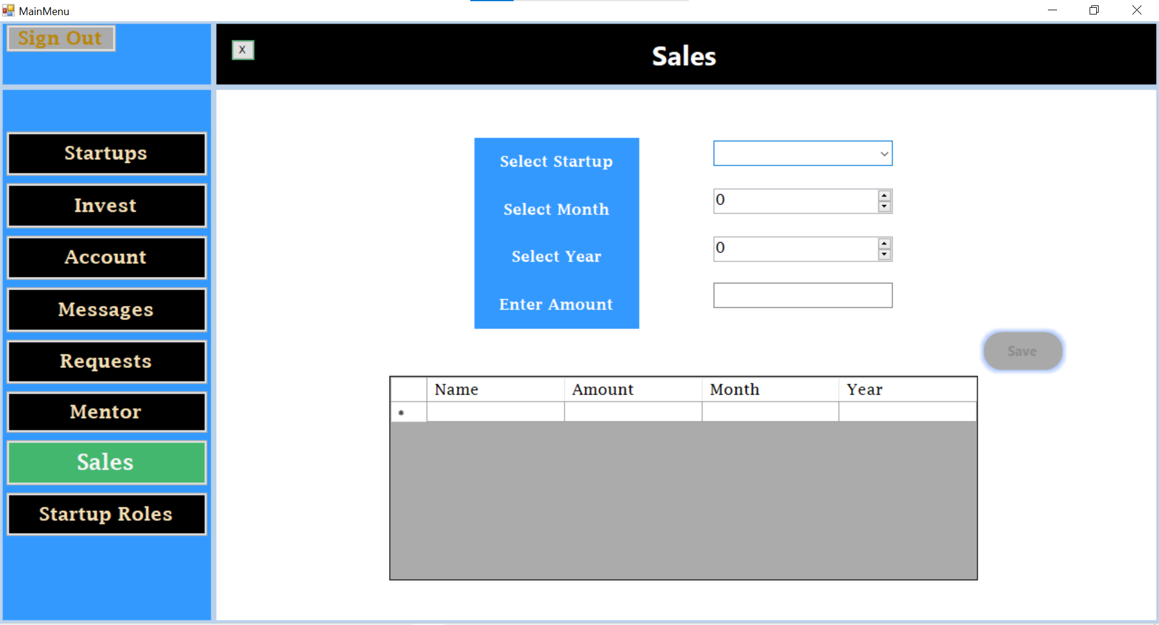
Sales:

Slide 22
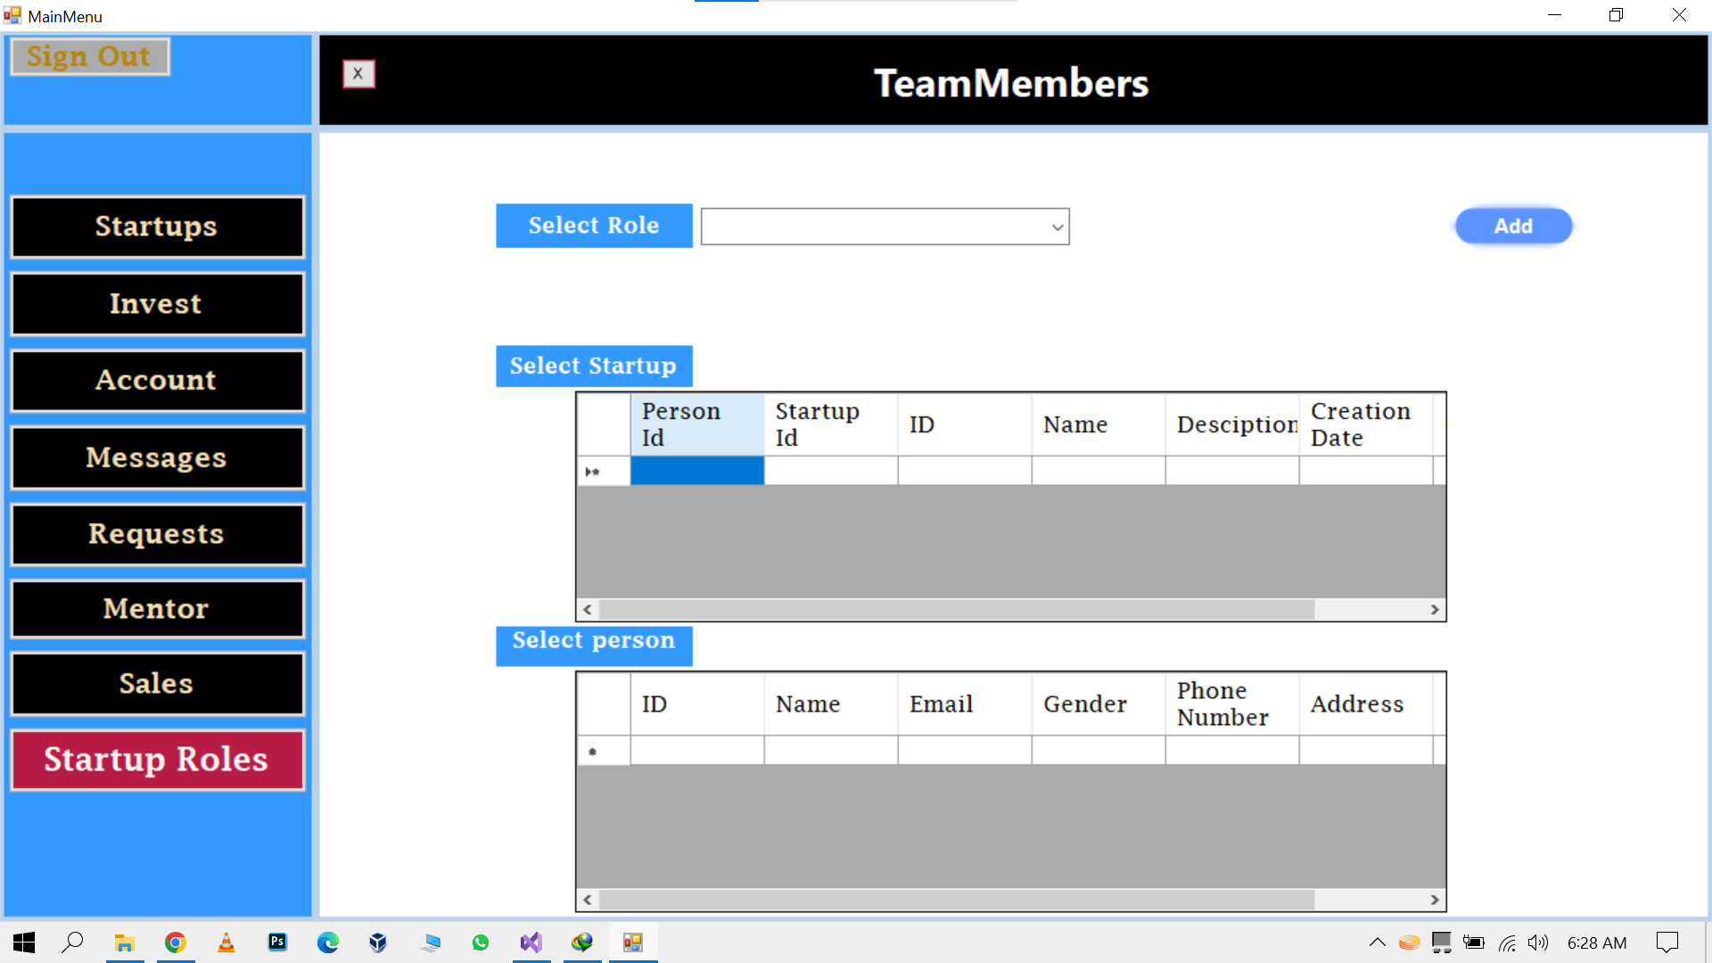
Startup Roles:

Slide 23
Thank you

